Slide 1

2022 Winter
UPDATA AI Study
Chap 6. Reinforcement Learning
Image from CS188 of Klein and Abbee

Slide 2
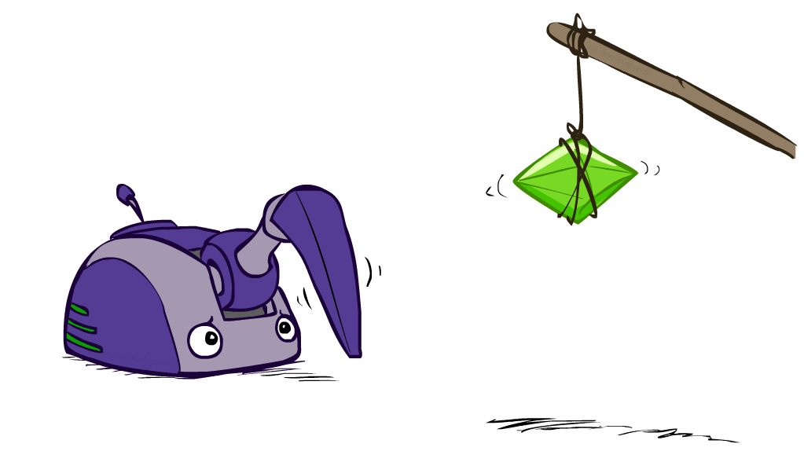
Reinforcement Learning
Image from CS188 of Klein and Abbee
Notes:
Stochastic vs. deterministic (vs. Non-deterministic)
변수나 프로세스가 deterministic하다는건 같은 시퀀스 안의 다음 사건이 지금 현재 사건으로부터 결정된다는 것이다. 그러니까 Stochastic과는 반대의 개념이다. deterministic algorithm은 같은 인풋을 넣으면 항상 같은 결과를 내는 알고리즘이다. 이에 반해 Non-deterministic algorithm은 인풋이 같아도 아웃풋은 다를 수 있다. stochastic variables or process은 아웃풋의 성질때매 deterministic하지 않다. 근데 이때 우리가 stochastic variables or process는 Non-deterministic이라고 해도 될까? 100% 같은 개념은 아니다. Non-deterministic은 오직 결과의 가능성만을 이야기 하기 때문이다. 한마디로 아웃컴과 분산이 중요한 확률(probability)을 이용한 분석에서는 Non-deterministic보다는 stochastic가 확실한 표현이 될 수 있다. stochastic은 확률이 정량화(quantified)되는데 반해 Non-deterministic는 확률적 개념이 들어있지 않다.

Slide 3
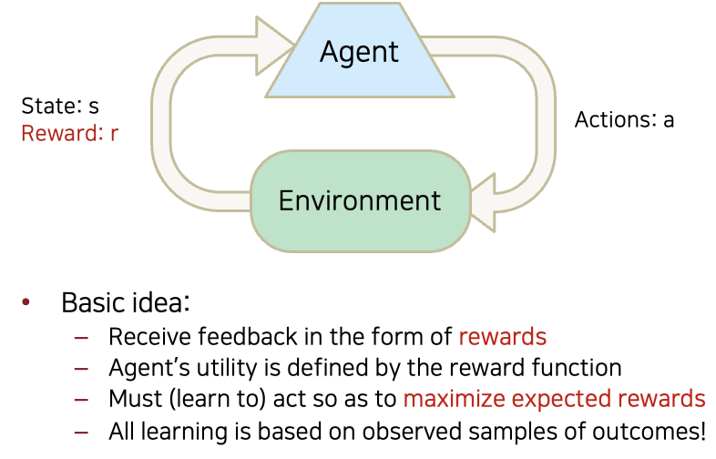
Reinforcement Learning
Slide credit: CS188 of Klein and Abbee

Slide 4
Reinforcement Learning
Still assume a Markov decision process (MDP):
A set of states s ∈ S
A set of actions (per state) A
A model T(s,a,s’)
A reward function R(s,a,s’)
Still looking for a policy π(s)
New twist: don’t know T or R
I.e. we don’t know which states are good or what the actions do
Must actually try actions and states out to learn
Slide credit: CS188 of Klein and Abbee

Slide 5
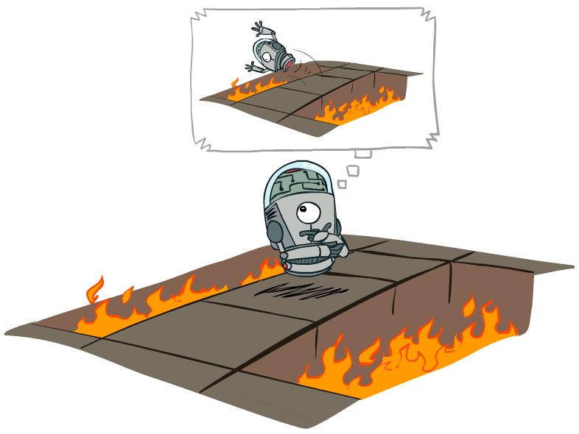
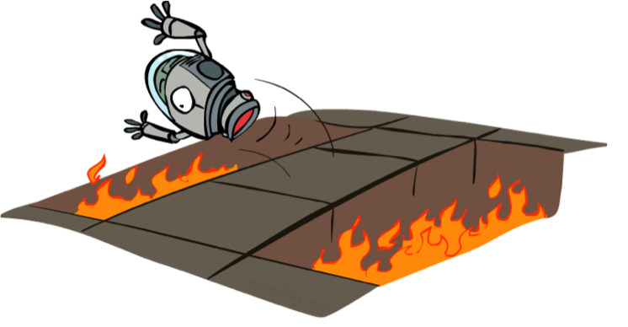
Offline (MDPs) vs. Online(RL)
Offline Solution
Online Learning
Slide credit: CS188 of Klein and Abbee

Slide 6
Model-Based Learning
Model-Based Idea:
Learn an approximate model based on experiences
Solve for values as if the learned model were correct
Step 1: Learn empirical MDP model
Count outcomes s’ for each s, a
Normalize to give an estimate of
Discover each when we experience (s, a, s’)
Step 2: Solve the learned MDP
For example, use value iteration, as before
Slide credit: CS188 of Klein and Abbee

Slide 7
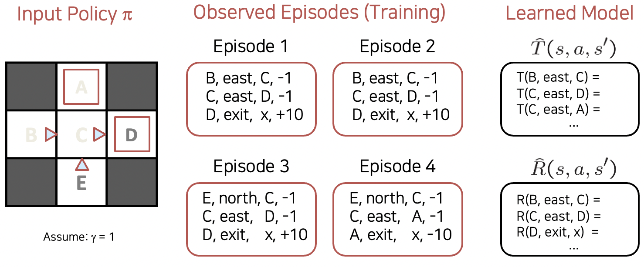
Example: Model-Based Learning
Slide credit: CS188 of Klein and Abbee

Slide 8
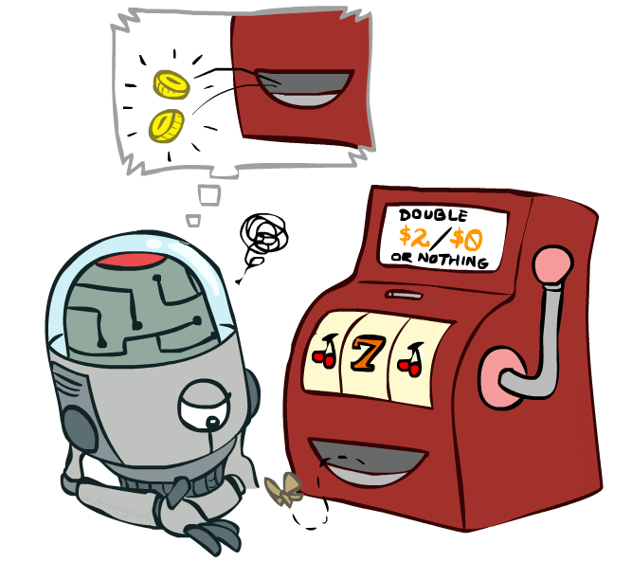
Model-Free Learning
Slide credit: CS188 of Klein and Abbee

Slide 9
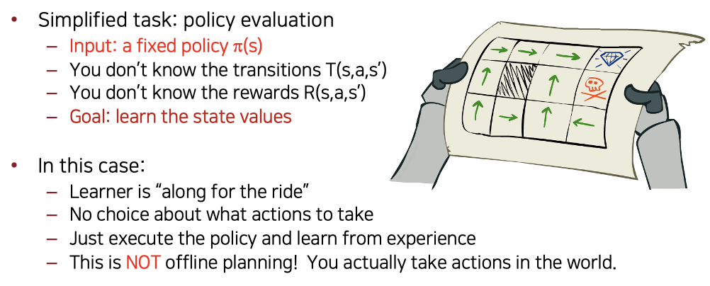
Passive Reinforcement Learning
Slide credit: CS188 of Klein and Abbee

Slide 10
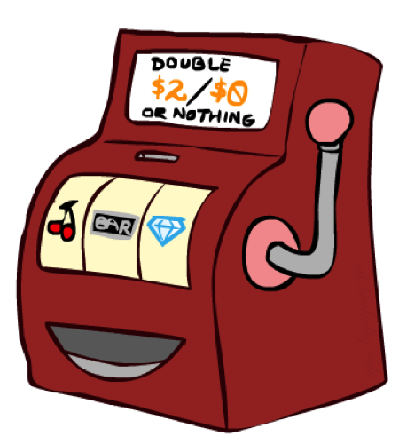
Direct Evaluation
Goal: Compute values for each state under π
Idea: Average together observed sample values
Act according to π
Every time you visit a state, write down what the sum of discounted rewards turned out to be
Average those samples
This is called direct evaluation
Slide credit: CS188 of Klein and Abbee

Slide 11
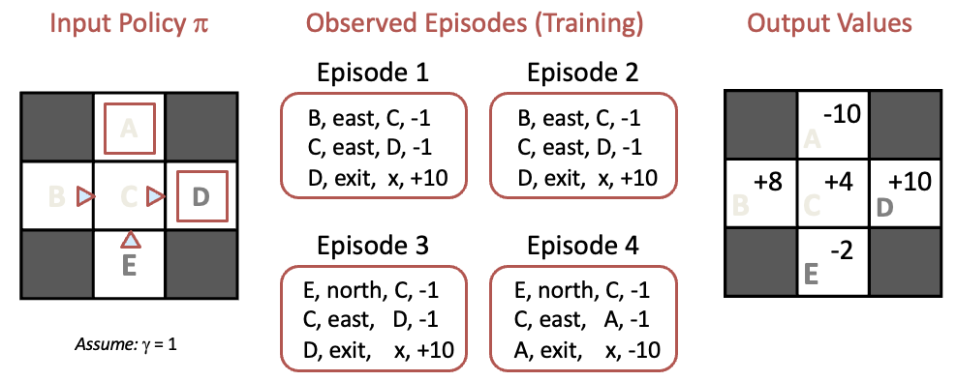
Racing Search Tree
Slide credit: CS188 of Klein and Abbee

Slide 12
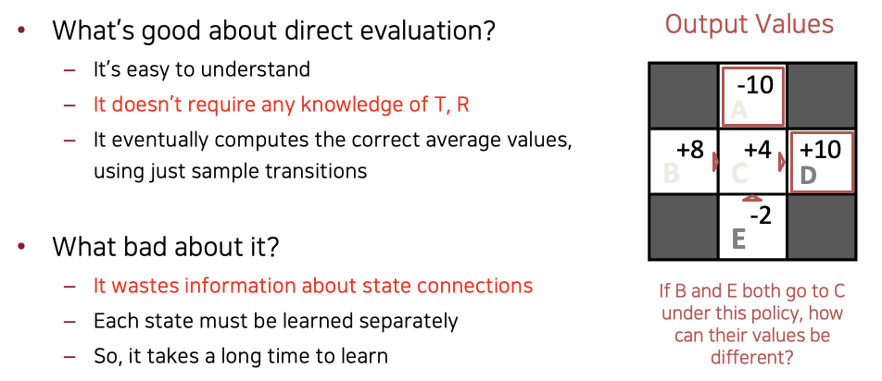
Problems with Direct Evaluation
Slide credit: CS188 of Klein and Abbee

Slide 13
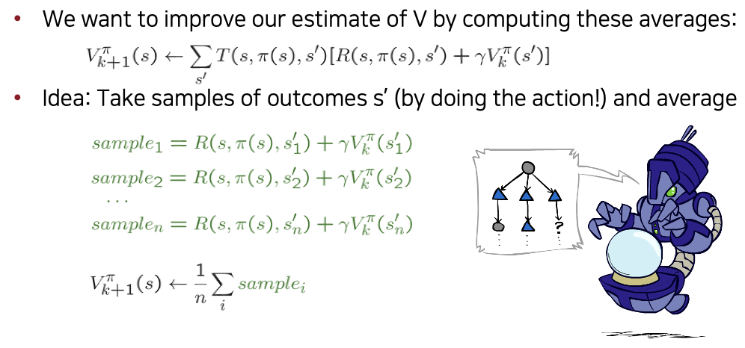
Sample-Based Policy Evaluation?
Slide credit: CS188 of Klein and Abbee

Slide 14
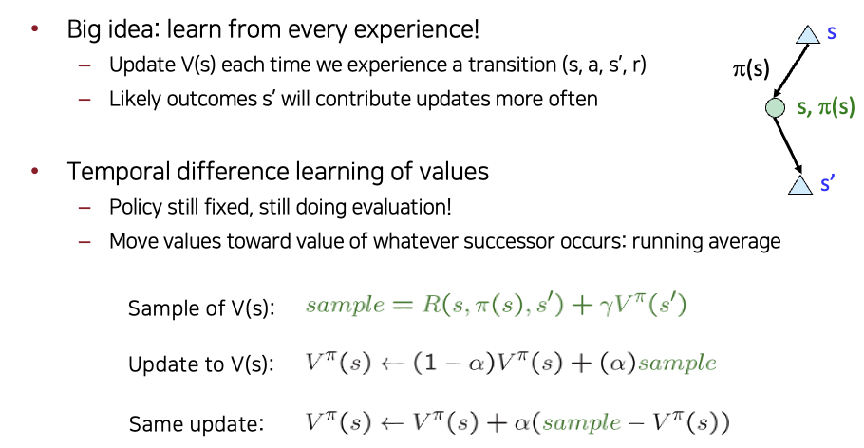
Temporal Difference Leaning
Slide credit: CS188 of Klein and Abbee

Slide 15
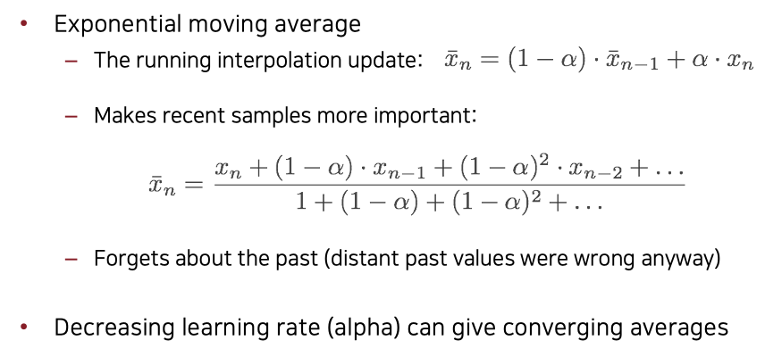
Exponential Moving Average
Slide credit: CS188 of Klein and Abbee

Slide 16
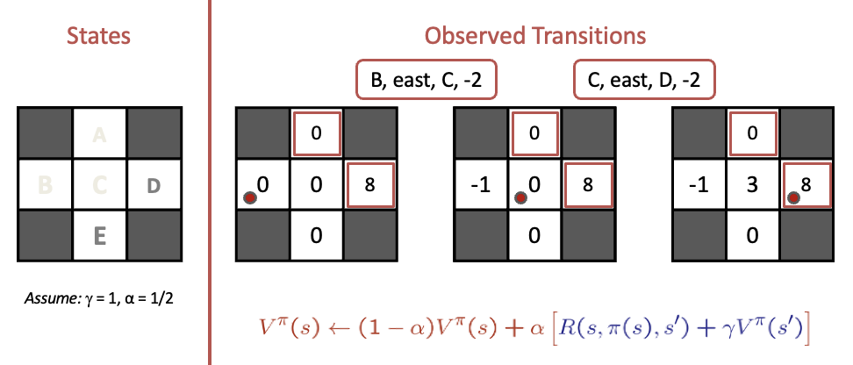
Example: Temporal Difference Learning
Slide credit: CS188 of Klein and Abbee

Slide 17
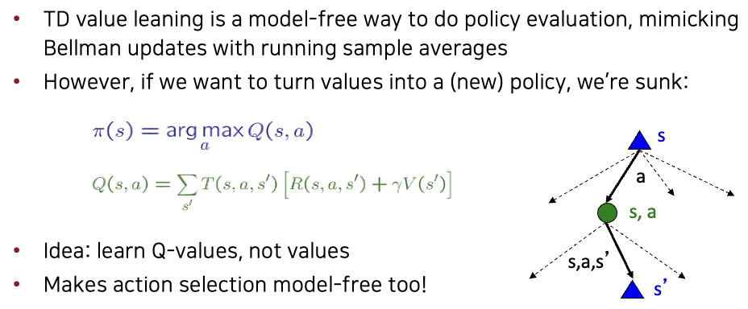
Problems with TD Value Learning
Slide credit: CS188 of Klein and Abbee

Slide 18
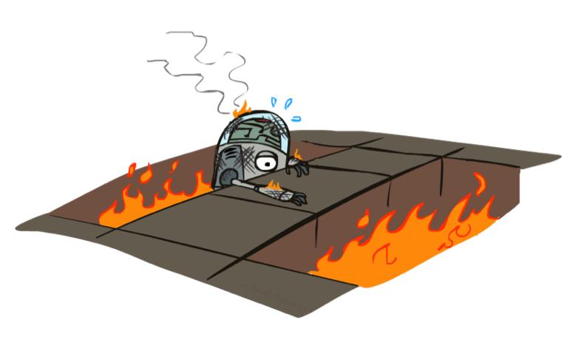
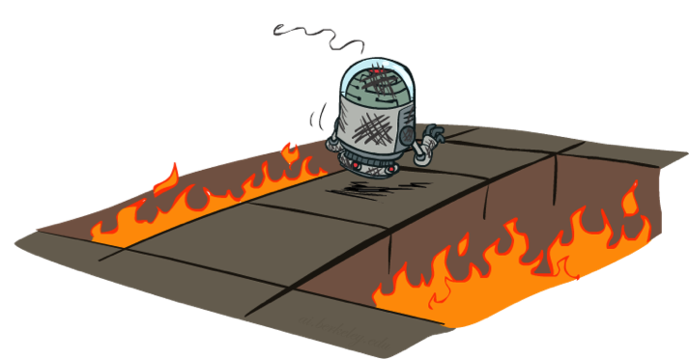
Active Reinforcement Learning
Slide credit: CS188 of Klein and Abbee

Slide 19
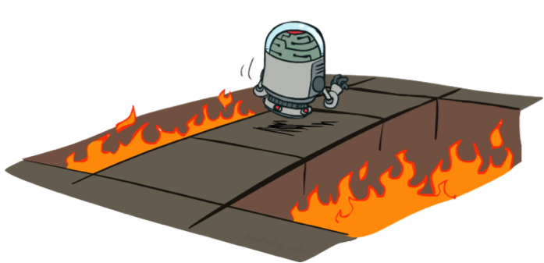
Active Reinforcement Learning
Full reinforcement learning: optimal policies (like value iteration)
You don’t know the transitions T(s,a,s’)
You don’t know the rewards R(s,a,s’)
You choose the actions now
Goal: learn the optimal policy / values
In this case:
Learner makes choices!
Fundamental tradeoff: exploration vs. exploitation
This is NOT offline planning! You actually take actions in the world and find out what happens…
Slide credit: CS188 of Klein and Abbee

Slide 20
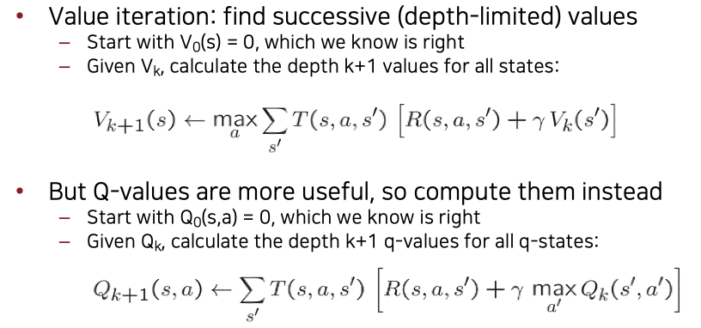
Detour: Q-Value Iteration
Slide credit: CS188 of Klein and Abbee

Slide 21
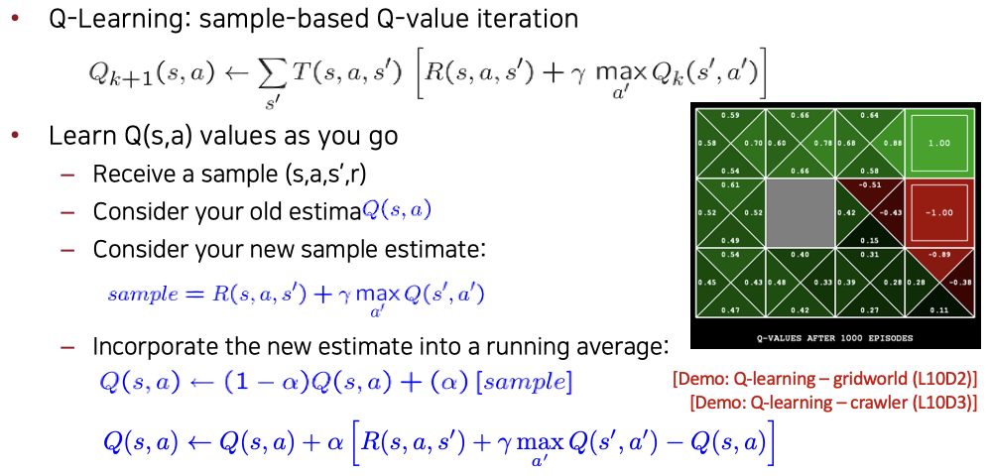
Q-Learning
Slide credit: CS188 of Klein and Abbee

Slide 22
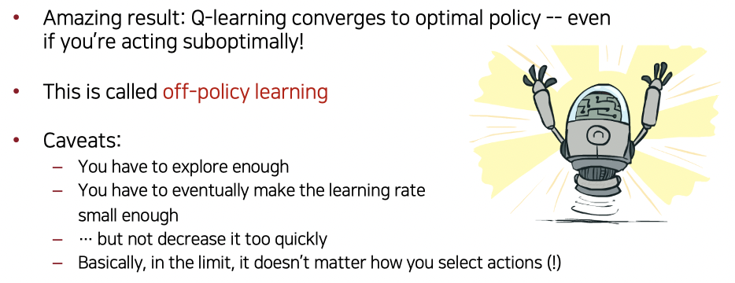
Q-Learning Properties
Slide credit: CS188 of Klein and Abbee

Slide 23
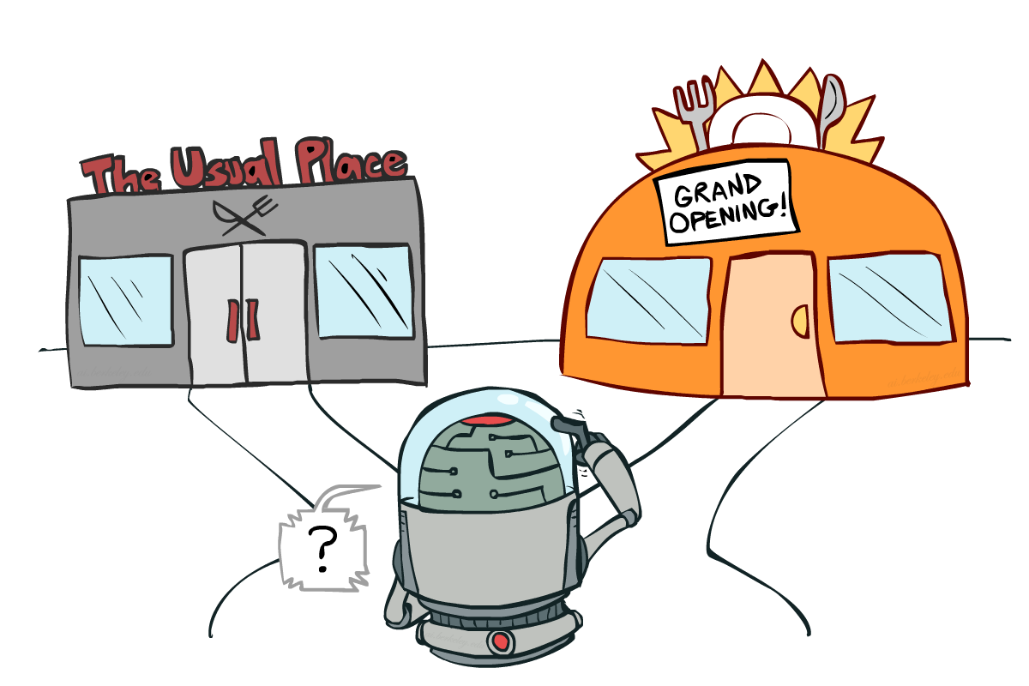
Exploration vs Exploitation
Slide credit: CS188 of Klein and Abbee

Slide 24
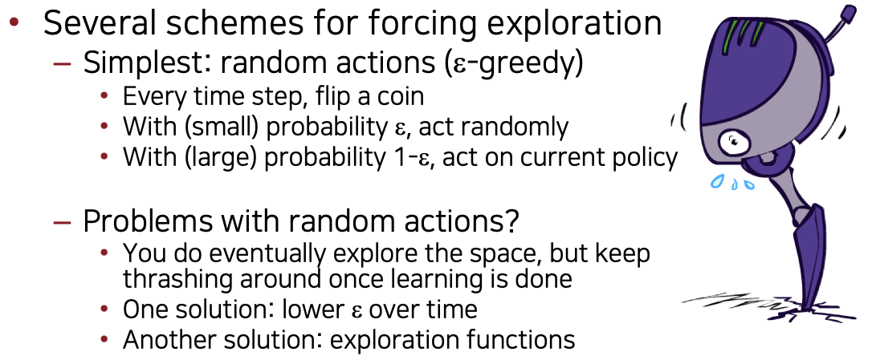
How to Explore?
Slide credit: CS188 of Klein and Abbee

Slide 25
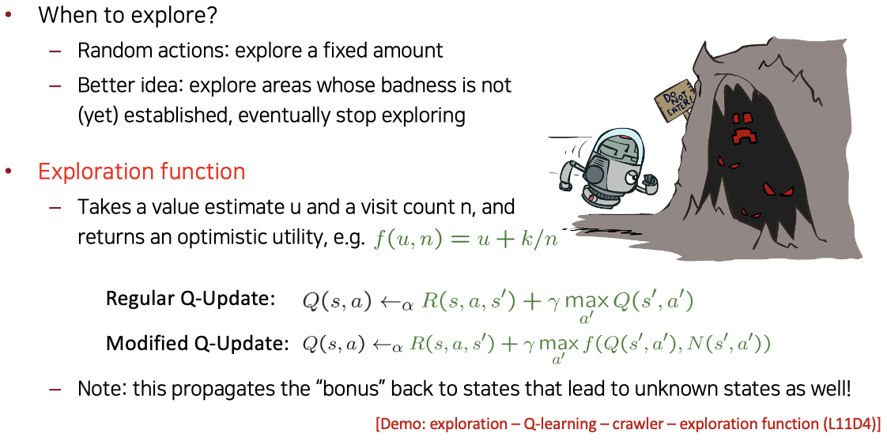
Exploratoin Functions
Slide credit: CS188 of Klein and Abbee

Slide 26
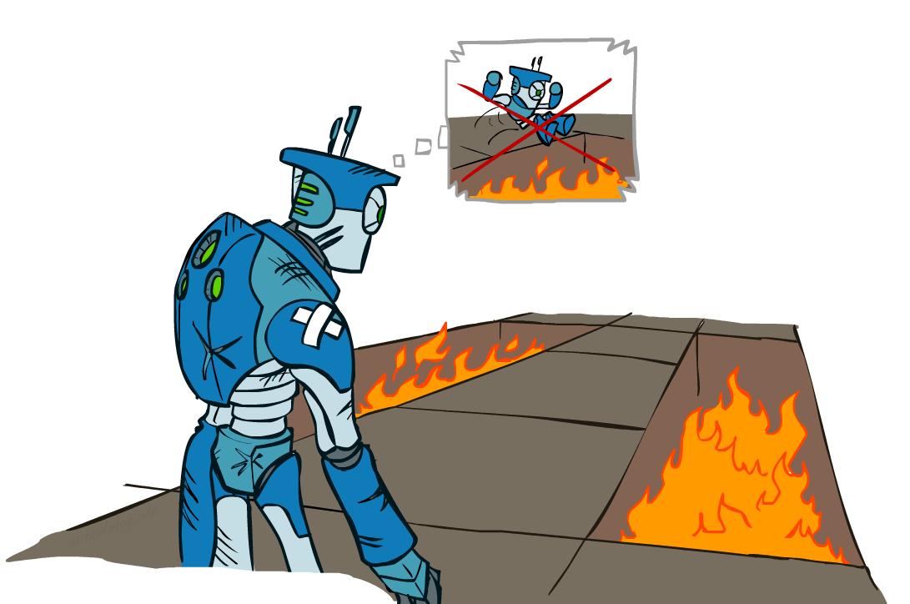
Regret
Even if you learn the optimal policy, you still make mistakes along the way!
Regret is a measure of your total mistake cost: the difference between your (expected) rewards, including youthful suboptimality, and optimal (expected) rewards
Minimizing regret goes beyond learning to be optimal – it requires optimally learning to be optimal
Example: random exploration and exploration functions both end up optimal, but random exploration has higher regret.
Slide credit: CS188 of Klein and Abbee

Slide 27

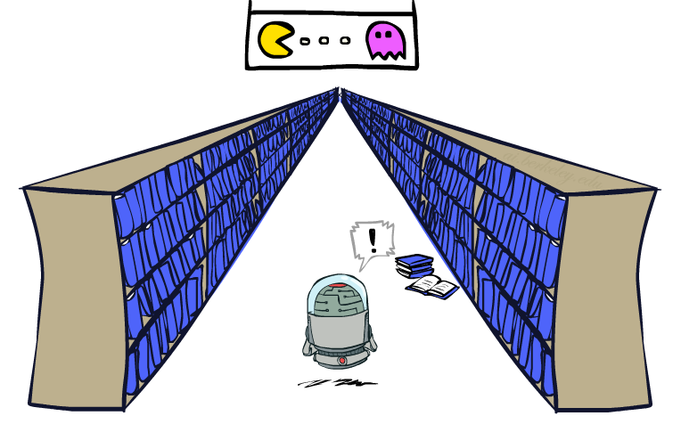
Generalizing Across States
Basic Q-Learning keeps a table of all q-values
In realistic situations, we cannot possibly learn about every single state!
Too many states to visit them all in training
Too many states to hold the q-tables in memory
Instead, we want to generalize:
Learn about some small number of training states from experience
Generalize that experience to new, similar situations
This is a fundamental idea in machine learning, and we’ll see it over and over again
Slide credit: CS188 of Klein and Abbee

Slide 28
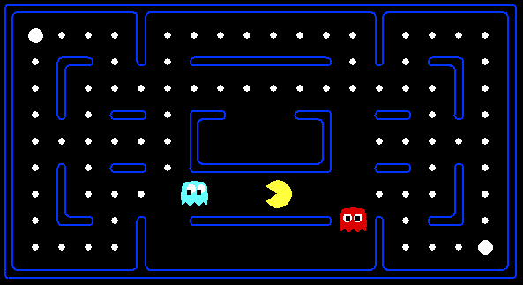



Feature-Based REpresentations
Solution: describe a state using a vector of features (properties)
Features are functions from states to real numbers (often 0/1) that capture important properties of the state
Example features:
Distance to closest ghost
Distance to closest dot
Number of ghosts
1 / (dist to dot)²
Is Pacman in a tunnel? (0/1)
…… etc.
Is it the exact state on this slide?
Can also describe a q-state (s, a) with features (e.g. action moves closer to food)
Slide credit: CS188 of Klein and Abbee

Slide 29
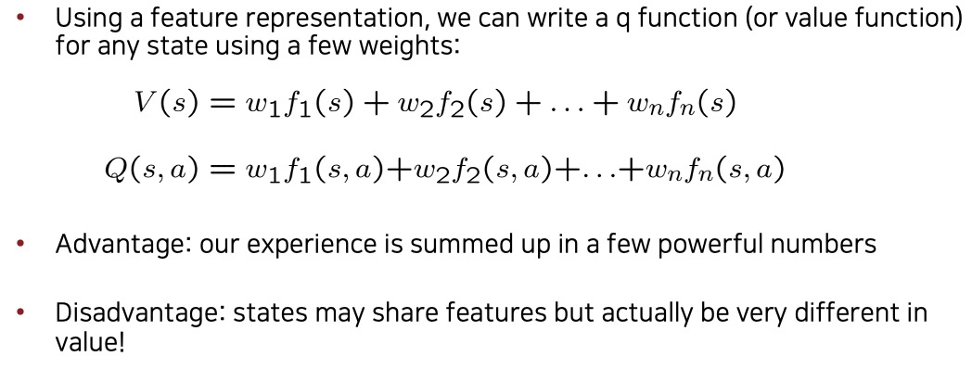
Linear Value Functions
Slide credit: CS188 of Klein and Abbee

Slide 30
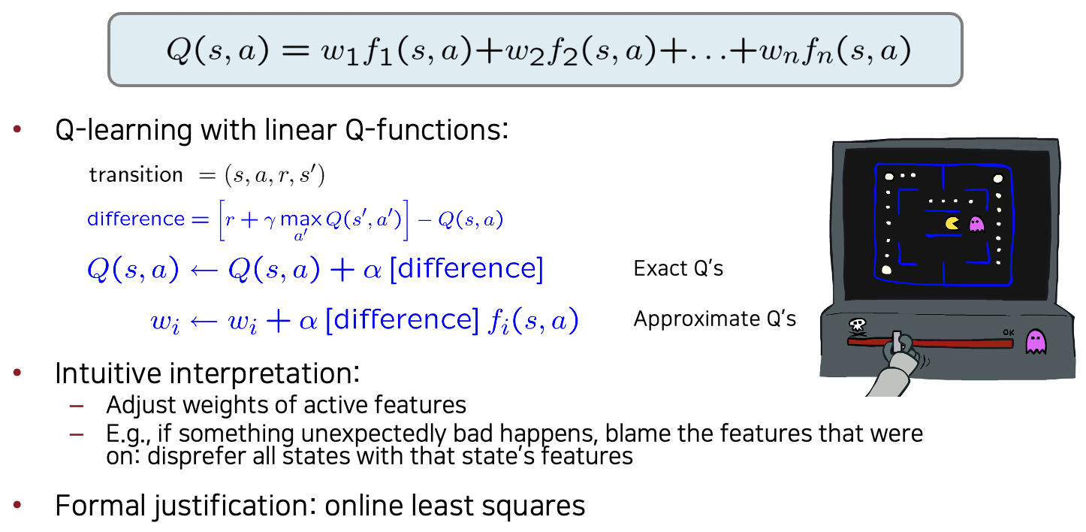
Approximate Q-Learning
Slide credit: CS188 of Klein and Abbee

Slide 31
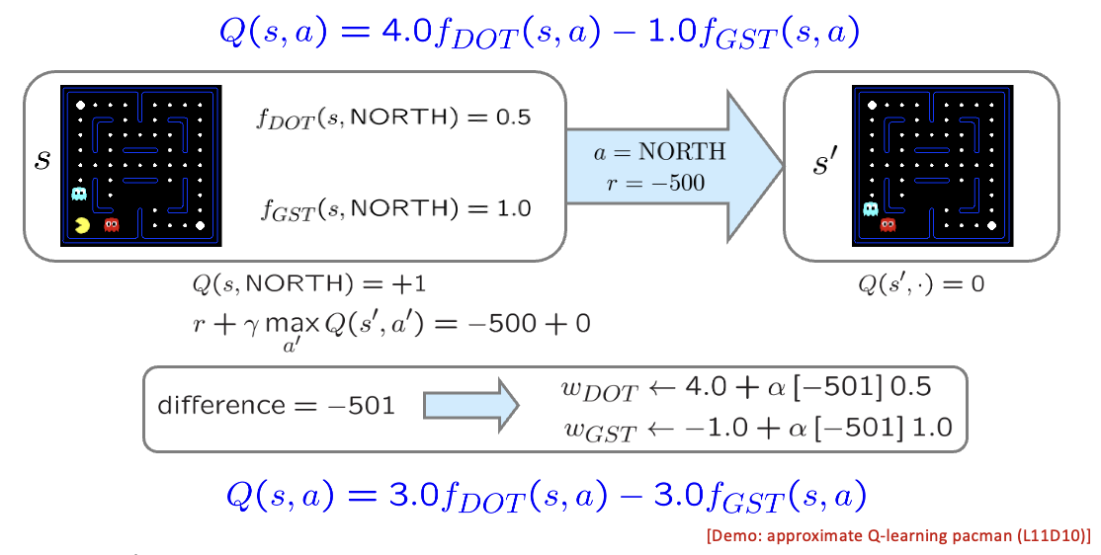
Example: Q-Pacman
Slide credit: CS188 of Klein and Abbee

Slide 32

Policy Search
Slide credit: CS188 of Klein and Abbee

Slide 33
Policy Search
Problem: often the feature-based policies that work well (win games, maximize utilities) aren’t the ones that approximate V / Q best
E.g. your value functions can be probably horrible estimates of future rewards, but they still can produce good decisions
Q-learning’s priority: get Q-values close (modeling)
Action selection priority: get ordering of Q-values right (prediction)
We’ll see this distinction between modeling and prediction again later in the course
Solution: learn policies that maximize rewards, not the values that predict them
Policy search: start with an ok solution (e.g. Q-learning) then fine-tune by hill climbing on feature weights
Slide credit: CS188 of Klein and Abbee

Slide 34
Policy Search
Simplest policy search:
Start with an initial linear value function or Q-function
Nudge each feature weight up and down and see if your policy is better than before
Problems:
How do we tell the policy got better?
Need to run many sample episodes!
If there are a lot of features, this can be impractical
Better methods exploit lookahead structure, sample wisely, change multiple parameters…
Slide credit: CS188 of Klein and Abbee

Slide 35
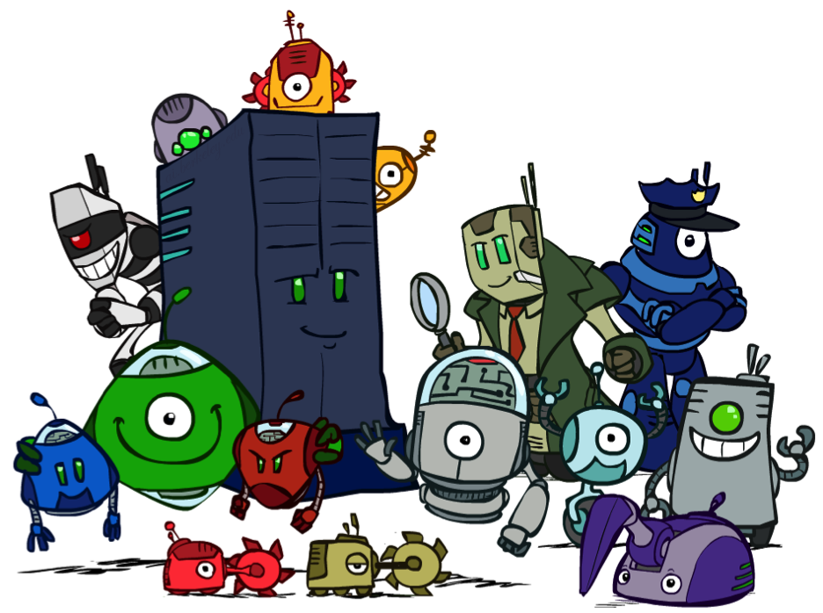
Conclution
We’re done with Part I: Search and Planning!
We’ve seen how AI methods can solve problems in:
Search
Constraint Satisfaction Problems
Games
Markov Decision Problems
Reinforcement Learning
Slide credit: CS188 of Klein and Abbee

